Slide 1
PRD Genie — AI-Powered Product Documentation Assistant
- Alok Ranjan Chakraverty
IK Mid June AI TPM Batch

Slide 2
Problem Statement
The Problem: PMs are drowning in documentation, not doing product work
Every sprint, PMs spend hours manually mining meeting transcripts for requirements.
Every PM formats PRDs differently — engineering can't estimate consistently.
Requirements sit buried in notes nobody revisits — until they resurface too late.
Result: delays, inconsistent tracking, slower time-to-market.

Slide 3
Solution – PRD Ginie an AI Assistant
The Solution: from transcript to structured PRD, automatically
A multi-agent AI system that extracts requirements, generates a standardized PRD, and breaks it into epics and user stories — grounded entirely in what was actually said.
Time back: hours reclaimed per sprint, redirected to product thinking.
Consistency: every PRD follows one structure — apples-to-apples estimation.
Traceability: nothing discussed gets lost or rediscovered three sprints later.
Validated against a 12-input baseline test suite — not just a demo.

Slide 4
PRD Ginie – Vision
PRD Genie transforms this process from a manual, inconsistent bottleneck into a multi-agent AI pipeline
Turning raw meeting transcripts, stakeholder notes, and product briefs into grounded, traceable PRDs and engineering-ready user stories.
The vision is not to remove PM judgment from the process, but to remove the manual transcription and formatting burden.
So PMs and TPMs spend their time on product strategy and stakeholder alignment instead of documentation.

Slide 5
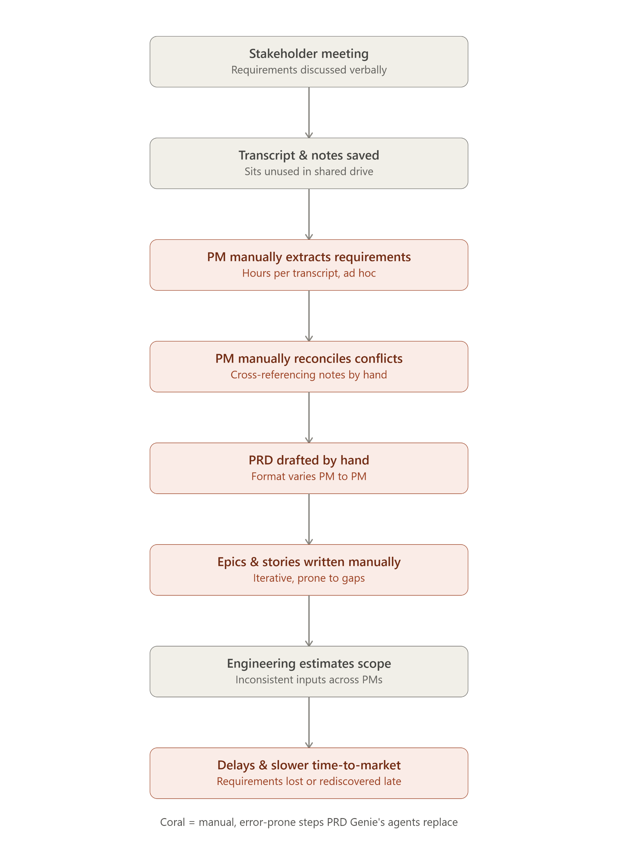
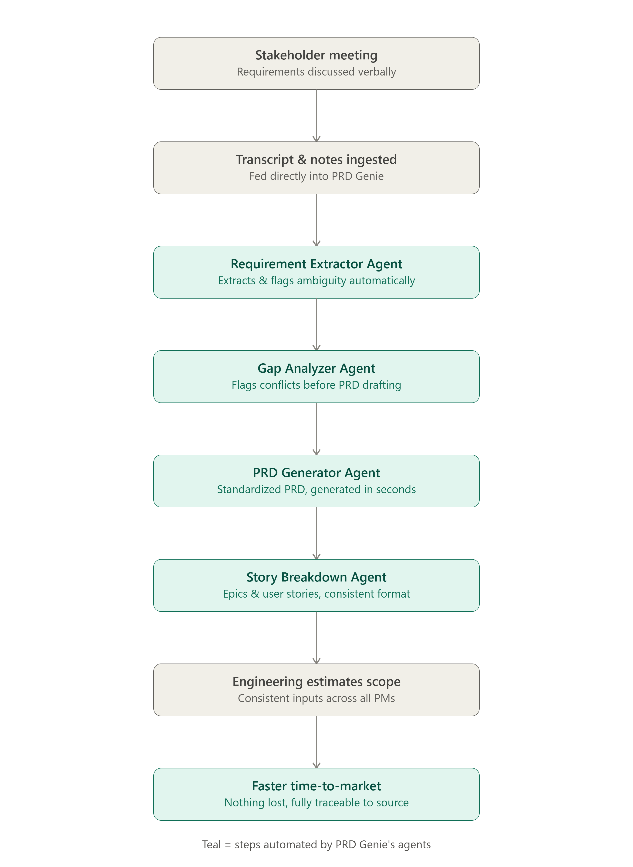
PRD Ginie - PM Workflow
Before — Manual PM Workflow | After — PRD Genie Pipeline

Slide 6
Why Multi Agent
Multi-Agent vs. Single-Agent
Multiple agents have defined, granular responsibility,
Makes the system easier to maintain and triage when something goes wrong
Evaluation traces and logs can pinpoint exactly which agent produced an issue.
Each agent can also be designed with guardrails specific to its role, reducing hallucination more effectively than one agent trying to do everything at once.

Slide 7
PRD Ginie - Objectives
Ground every generated requirement in a traceable source document — zero fabricated requirements, metrics, or personas.
Standardize PRD structure across all inputs via a single shared template
Surface every cross-source conflict, stakeholder tension, and open question for explicit human resolution — never silently resolve ambiguity on the PM's behalf.
Convert the finalized PRD into properly persona-separated, correctly prioritized Epics, Features, and User Stories.
Establish a measurable evaluation baseline (a 12-input test suite plus Langfuse tracing)

Slide 8
PRD Ginie – Scope
Core sequential pipeline:
Requirement Extractor → Gap Analyzer → PRD Generator → Critique/Resolver loop → Story Breakdown.
Gap Analyzer as the selected Extended Capability — cross-source conflict detection, stakeholder tension surfacing, and consolidated clarification questions.
PRD generation against a fixed, externally swappable template, grounded strictly in extracted requirements and gap analysis.
Epic/Feature/User Story breakdown with persona separation, priority inheritance, and preserved contested-item status.
A deterministic, code-based completeness validation step, independent of LLM self-review.
Observability and tracing via Langfuse across all agents, with baseline test documentation.

Slide 9
Out of Scope (this iteration)
Scope Estimator and Version Comparison — alternative Extended Capabilities not selected for this build.
Fine-tuning of the Requirement Extractor on messy transcript data.
RAG-based retrieval over a historical library of past PRDs (the current template is embedded as a static, swappable input rather than retrieved).
Automated ticket creation in Jira/Confluence or other downstream PM tooling integration.

Slide 10
Design and Architecture Details
Design and Architecture Details
PRD Genie is built as a multi-agent pipeline in n8n: source documents are ingested from Google Drive, passed through a chain of LLM agents and deterministic checks, and exported as a traced, evaluated result. The pipeline is not a single straight line — it includes two deterministic decision gates that can short-circuit or conditionally extend the flow depending on what earlier stages find.
Stage-by-stage breakup*
Source documents (Google Drive) — Search → Download → Extract
Requirement Extractor Agent → Requirement Aggregator
Check If Empty Requirement (deterministic gate)
Gap Analyzer Agent — cross-references the consolidated requirements
*Agent Details are provided in the writeup for the Response of Q3 for “Build PRD Genie”

Slide 11
Design Contd.
PRD Template (Set) → Merge → PRD Generator Agent
Critique Agent → Resolver Agent
Grounding Validator (deterministic, Code node)
Final PRD — the grounded, validated checkpoint passed to Story Breakdown.
Story Breakdown Agent → Story Evaluator (deterministic) → Completeness Gate
Story Finalizer Agent (conditional) — invoked only if the Completeness Gate finds gaps;
Prepare Langfuse Payload → Langfuse ingestion
*Agent Details are provided in the writeup for the Response of Q3 for “Build PRD Genie”

Slide 12
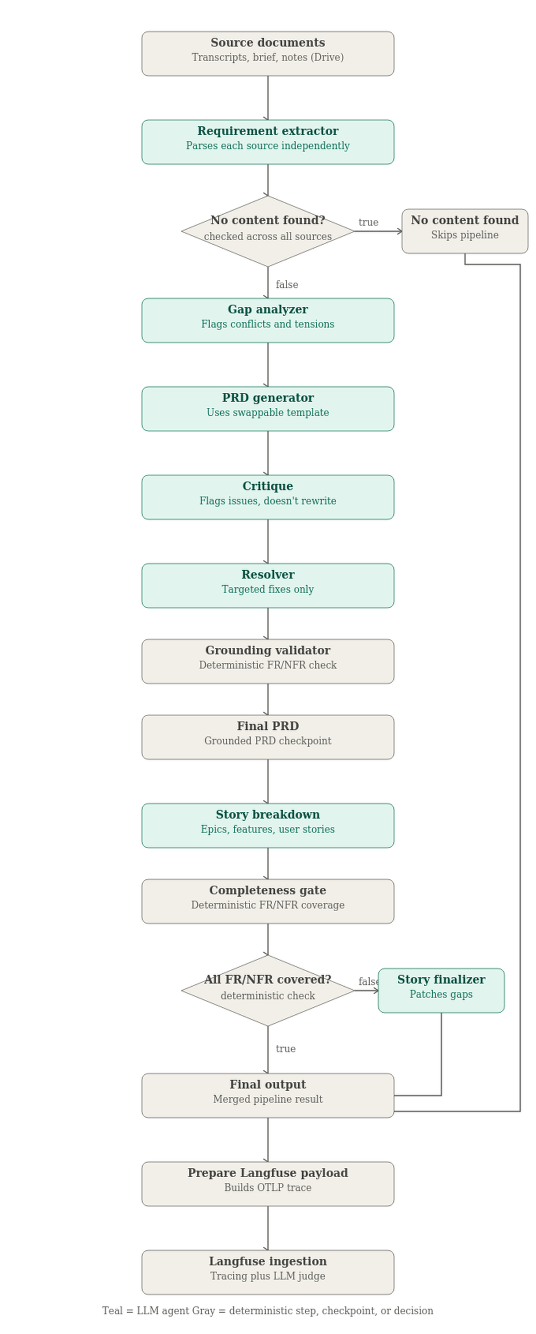
PRD Ginie - Architecture Diagram

Slide 13
Orchestration Pattern
PRD Genie uses a Sequential Pipeline as its primary orchestration pattern
Requirement Extraction → Gap Analysis → PRD Generation → Story Breakdown
With two reflection sub-patterns layered on top
A Critique → Resolver loop after PRD generation,
And a Story Evaluator → Story Finalizer conditional patch after Story Breakdown.
A deterministic short-circuit also breaks the strict sequential flow: if the Requirement Extractor finds nothing extractable across all sources, the pipeline terminates immediately rather than running five more agents against empty input

Slide 14
TOOL CHOICE
n8n — a visual, debuggable node graph was essential given how many multi-agent handoff bugs this build surfaced during development
OpenAI structured outputs (strict JSON Schema) — used at every agent boundary so each agent receives a stable, parseable shape from the one before it
Google Drive — chosen as the ingestion source specifically to address the “documents sit unused” pain point, rather than requiring manual paste-in.
Langfuse — connected via OTLP export from Code nodes rather than a native LangChain integration, since n8n is not a LangChain-based stack
Deterministic Code nodes — used in place of additional LLM calls wherever a check is mechanically verifiable

Slide 15
Observability
All seven LLM agents plus both deterministic checks are traced through a single pipeline run using Langfuse,
Connected via a manually constructed OTLP export rather than a native LangChain integration (n8n is not a LangChain-based stack,
This required assembling OTLP trace/span payloads by hand, using Langfuse-specific semantic attribute keys such as langfuse.trace.* and langfuse.observation.*)
Trace structure : Each run produces one parent trace with a child span per stage. Every trace is tagged with batch_id & expected_criteria metadata identifying which baseline test(s)
LLM-as-Judge evaluation. A Langfuse Evaluator, configured with its own model connection, scores each trace's final output against its tagged expected_criteria and attaches a pass/fail score with written reasoning
Short-circuit : When the Requirement Extractor finds zero stated requirements, ambiguous items, or missing information across every source, the pipeline terminates immediately after extraction rather than running five more agents against empty input.

Slide 16
Baseline Test
All the 12 Baseline test cases are tested by creating relevant sample input files using LLM
Combining the test cases where possible, thus the 12 test cases are captured in 7 Sample Input files S1 through S7.
The Expected Criteria and file name along with an Identifier Batch ID is selected in the Batch Selector Node
Once the tracing available in Langfuse, the result is tested via LLM based evaluator that scores 0/1 for fail and pass and provides a model reasoning summary for the result
**All Test case details with dataset tested and results are documented in file “Test Cases.xlsx”

Slide 17
Cost Analysis
Agent | Temperature | Calls | Input token | Output token | Cost | Source
Requirement Extractor | 0.2 | 3 | 3,956 | 1,975 | $0.0018 | Measured
Gap Analyzer | 0.2 | 1 | 2,286 | 346 | $0.0006 | Measured
PRD Generator | 0.2 | 1 | 3,920 | 1,577 | $0.0015 | Measured
Critique Agent | 0.0 | 1 | 5,015 | 724 | $0.0012 | Measured
Resolver | 0.2 | 1 | 6,282 | 1,721 | $0.0020 | Measured
Story Breakdown | 0.2 | 1 | 3,252 | 1,898 | $0.0016 | Measured
Story Finalizer (conditional) | 0.2 | 1 | ~5,100 | ~1,625 | $0.0017 | Estimated
Total | — | 9 calls | ~29,811 | ~9,866 | ≈$0.0104 | Mixed

Slide 18
Reflection
Findings -
This capstone was less about getting a pipeline to “work” on the first try and more about learning to distrust clean-looking output until I'd actually traced how it got there. Nearly every agent in this build passed a first test convincingly and then failed a second one in a quieter, more specific way
A misconfigured merge caused the PRD Generator to receive fragmented input; instead of failing, it confidently fabricated
A Critique agent contradicted itself within the same report
A Resolver correctly preserved a contested item's status on one run, then stripped it on a near-identical run
A Story Breakdown agent applied a rule correctly to one requirement while silently dropping an identical case elsewhere in the same output

Slide 19
Reflection Contd.
Improvement Plan –
Replace more prompt-only self-verification with deterministic, code-based checks
Turn every real issue found during testing into a permanent regression test case, not just a one-time prompt fix.
Measure the Critique/Resolver loop's actual value against its cost — it roughly triples LLM calls for PRD generation alone.
Incrementally patching a prompt one issue at a time, rule by rule, quietly accumulates structural clutter and even outright conflicting instructions across sections — needed a separate, non-bug-driven pass to review and restructure a prompt's overall organization

